Slide 1
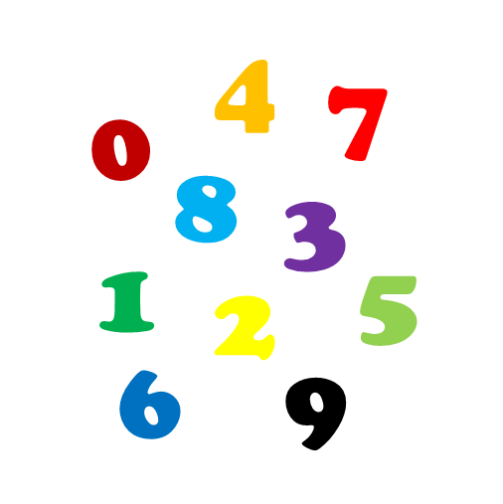
Data Types
Nina Gunnes
June 3, 2021

Slide 2
Data types
Two main types of data
  Categorical
  Numerical
Depending on the operationalization of concepts or characteristics
  Pain
  Body function (e.g., being able-bodied)
  Quality of life
Determining the choice of statistical method for data analysis

Slide 3
Data types, cont.
Different operational definitions of smoking habits
1. Are you a smoker? [ ] yes [ ] no
2. Are you a [ ] smoker [ ] former smoker [ ] non-smoker?
3. How many cigarettes do you smoke per day on average? […]
4. Are you a [ ] non-smoker [ ] former smoker [ ] occasional smoker [ ] moderate smoker [ ] heavy smoker (at least 20 cigarettes/day)?
5. Evaluate your smoking habits on a scale from 0 (non-smoker) to 4 (heavy smoker, at least 20 cigarettes/day): 0 1 2 3 4
6. Evaluate your smoking habits on a scale from 0 (non-smoker) to 10 (heavy smoker, at least 20 cigarettes/day): 0 1 2 3 4 5 6 7 8 9 10
7. For how many years have you been smoking? […]
Based on Table 2.1 in Laake et al. (2007)

Slide 4
Categorical data
Dividing data set into categories, or groups
Values not necessarily representing an exact measure
Dichotomous data being the simplest form of data
  Data set grouped into two categories (e.g., exposed and unexposed)
  Statistical description based on the number or proportion in each category
Two levels of measurement
  Nominal
  Ordinal

Slide 5
Nominal data
Unordered categorical data
Grouping the data set into categories of no natural order
  Toxic substances of exposure
  Side effects of medication
Potentially overlapping groups
  Subjects belonging to more than one category
  Sum of category frequencies greater than the total number of subjects
Summarized by frequency distribution, bar chart, pie chart, etc.

Slide 6
Ordinal data
Ordered categorical data
Grouping the data set into categories of some natural order
  Category A > Category B > Category C > … (or vice versa)
Categories representing an ordered sequence
  Smoking habits: non-smoker, former smoker, smoker
  Health: very good, good, less good, bad
Only (!) expressing an ordering of the data
  No information about quantity or distance between categories

Slide 7
Ordinal data, cont.
“Conversely, where ordered categories are numbered, as with stage of disease or social class, the temptation to treat these numbers as statistically meaningful must be resisted. For example, it is not sensible to calculate the average social class or stage of cancer. The only information the numbers contain is in the ordering, which would be conveyed equally by calling them A, B, C, D and so on.”
Altman (1991), page 12

Slide 8
Ordinal data, cont.
Extremes sometimes encoded as 0 and 100, respectively
  Impression of more possible values than the limited number of categories
Numerical codes often (erroneously!) treated as ordinary numbers
  Meaningless to add, subtract, or average ordinal data
Described by frequencies and appropriate descriptive statistics
  Median
  Quartiles
Statistical analysis unaffected by the choice of numerical codes

Slide 9
Ordinal data, cont.
Examples of different scales for ordered responses
Letter scale | A, B, C, D, …
Numerical scale | 1, 2, 3, …
 | 0, 1, 2, …
 | 1, …, 10
Verbally descriptive scale | None – Weak – Moderate – Strong
 | All the time – Most of the time – Part of the time – Little of the time – None of the time
 | Very bad – Bad – Less good – Good
Pictograms | ☹☹☹ ☹☹ ☹ 😐 ☺ ☺☺ ☺☺☺
Symbols | (-) (+) (++) (+++)
Visual analog scale (VAS) | Nothing ――――――――――― Extremely
 | Extremely strong ――――――――――― Extremely weak
Based on Table 2.5 in Laake et al. (2007)

Slide 10
Visual analog scale (VAS)
Forming approximately continuous ordinal data
Often a 100 mm straight line
Measurement given by a marking on the line
  Value between two extremes
  Many possible positions
Different definitions of the extremes
  Perceived level of discomfort, pain, etc.: 0 – nothing vs. 100 – extreme
  Bipolar (two opposite characteristics): uncertain vs. self-confident

Slide 11
Numerical data
Mathematically the highest form of data
Clearly defined quantity and distance between values
  “Twice as much”
  “Decrease of 5 kg”
Several options for describing and analyzing the data
  Median and mean both valid
Important information from scatter plot or histogram
  Indication of suitable methods to apply

Slide 12
Numerical data, cont.
Four different types
  Count data
  Continuous non-negative data
  Continuous interval-limited data
  Continuous unlimited data
Continuous numerical data not requiring any decimals
Important to distinguish non-negative data from other numerical data
  Often right-skewed (i.e., long right tail)

Slide 13
Numerical data, cont.
Descriptive statistics depending on the distribution
  Median and quartiles for non-negative data
  Mean and standard deviation for continuous unlimited data
Two levels of measurement
  Interval (no true zero point): temperature in Fahrenheit or Celsius, dates, etc.
  Ratio (a true zero point): height, weight, age, etc.

Slide 14
Summary
Categorical data
Dichotomous data | Exposure: exposed, unexposed
 | Obesity: obese, non-obese
 | Smoking habits: smoker vs. non-smoker
 | Sex: male, female
Nominal data | Type of strenuous work (heavy lifting, monotone working posture, etc.)
 | Name of toxic/carcinogenic substance of exposure
Ordinal data | Smoking habits: non-smoker, former smoker, smoker
 | Blood pressure: low, normal, high
 | Degree of overweight: moderate, high, very high
 | Pain: 0, 1, 2, 3, 4
 | Perceived health: very good, good, less good, bad
Based on Table 2.4 in Laake et al. (2007)

Slide 15
Summary, cont.
Numerical data
Count data | Number of diseased or deceased
 | Number of cigarettes smoked per day
Continuous non-negative data | Time as a smoker (years)
 | Blood pressure (mmHg)
 | Degree of overweight: body mass index (kg/m²)
 | Concentration of toxic/carcinogenic substance in the blood (mg/ml, mmol/ml)
Continuous interval-limited data | Drug uptake (%)
 | Degree of overweight: percentage of body fat measured by densitometry (%)
Continuous unlimited data | Change in body weight (kg)
 | Change in blood pressure (mmHg)
 | Change in total cholesterol (mmol/l)
Based on Table 2.4 in Laake et al. (2007)

Slide 16
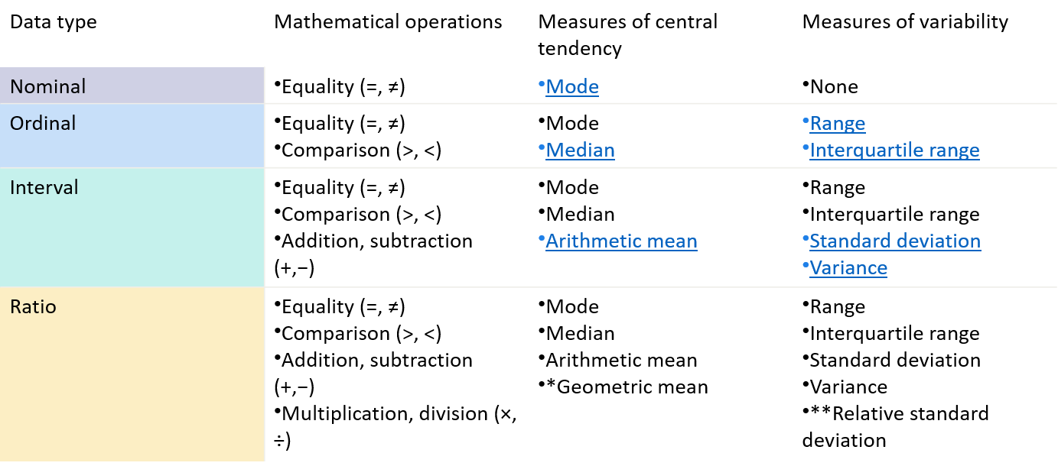
Summary, cont.
Scribbr, https://www.scribbr.com/statistics/levels-of-measurement/ (June 2, 2021)

Slide 17
References
Laake P, Hjartåker A, Thelle DS, Veierød MB. Epidemiologiske og kliniske forskningsmetoder. Oslo: Gyldendal akademisk; 2007. https://www.med.uio.no/imb/forskning/publikasjoner/boker/2007/epidemiolgiske-kliniske-forskningsmetoder.html.
Scribbr. Levels of measurement: Nominal, ordinal, interval, ratio. July 16, 2020. Revised January 27, 2021. Accessed June 2, 2021. https://www.scribbr.com/statistics/levels-of-measurement/.
Statistics Solutions. Data Levels of Measurement. 2021. Accessed June 2, 2021. https://www.statisticssolutions.com/dissertation-resources/descriptive-statistics/data-levels-of-measurement/.

